Slide 1
PLATE TECTONIC THEORY
WHAT IS PLATE?
The rigid lithospheric slab or rigid and solid crustal are technically called ‘plates’. (Also called lithospheric plate) The whole mechanism of the evolution, nature and motion of plates and resultant reaction is called ‘plate tectonic’.
In other worlds, the whole process of plate motion is referred to as plate tectonics.
A tectonic plate is a massive, irregularly-shaped slab of soil rock, generally composed of both continental and oceanic plate.
Plate move horizontally over the asthenosphere as rigid unit.
Plate tectonic theory, a great scientific achievement of the decade of 1960s, is based on two major scientific concepts.
The concept of continental drift and
The concept of sea floor spreading.

Slide 2
‘Plate’ word
The term ‘plate’ was first used by Canadian geophysicist J.T. Wilson in 1965AD.
McKenzie and Parker discussed in detail the mechanism of plate tectonic.
The theory of plate tectonics propose that the earth lithosphere is divided into seven major and twenty minor plates.
Major plates are as follows:-
1) Antarctica and the surrounding oceanic plate.
2) North America (with western Atlantic floor separated from the south America plate along the Caribbean islands.
3) South America plate (with western Atlantic floor separated from the north America plate along with the Caribbean islands).
4) Pacific plate.
5) India- Australia-New Zealand plate.
6) Africa with the eastern Atlantic plate
7) Eurasia and adjacent oceanic plate

Slide 3
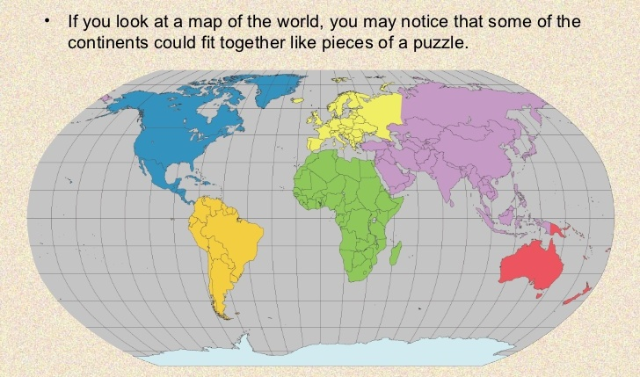
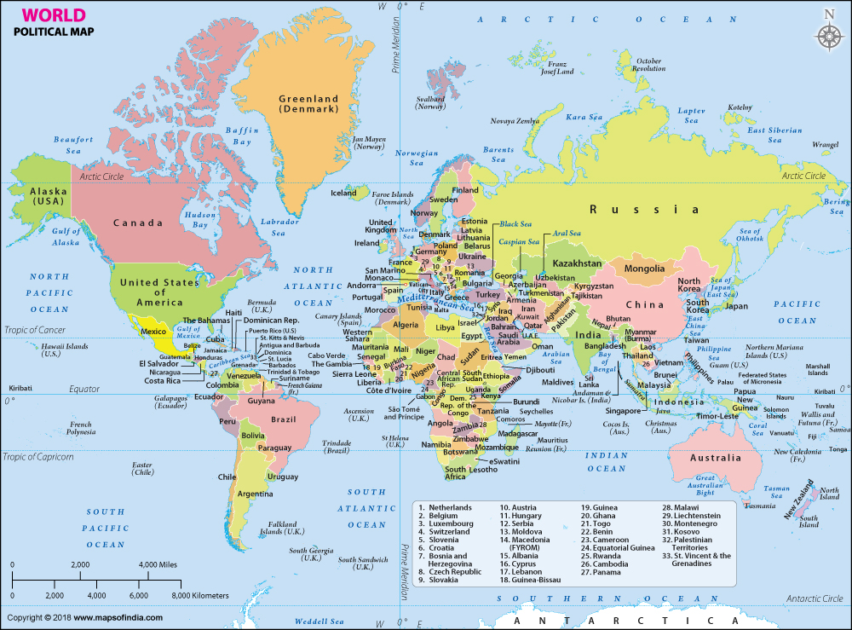

Slide 4
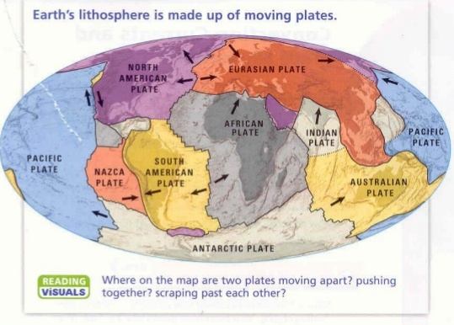

Slide 5
It may be highlighted that tectonically plate boundaries or plate margins are most important because all tectonic activities occur along the plate margins like seismic events, vulcancity, mountain building, faulting etc.
Plate margins are generally divided into three groups. These are……
1). Constructive plate margins or divergent plate margins.
2) Destructive plate margins or convergent plate margins.
3) Conservative plate margins

Slide 6
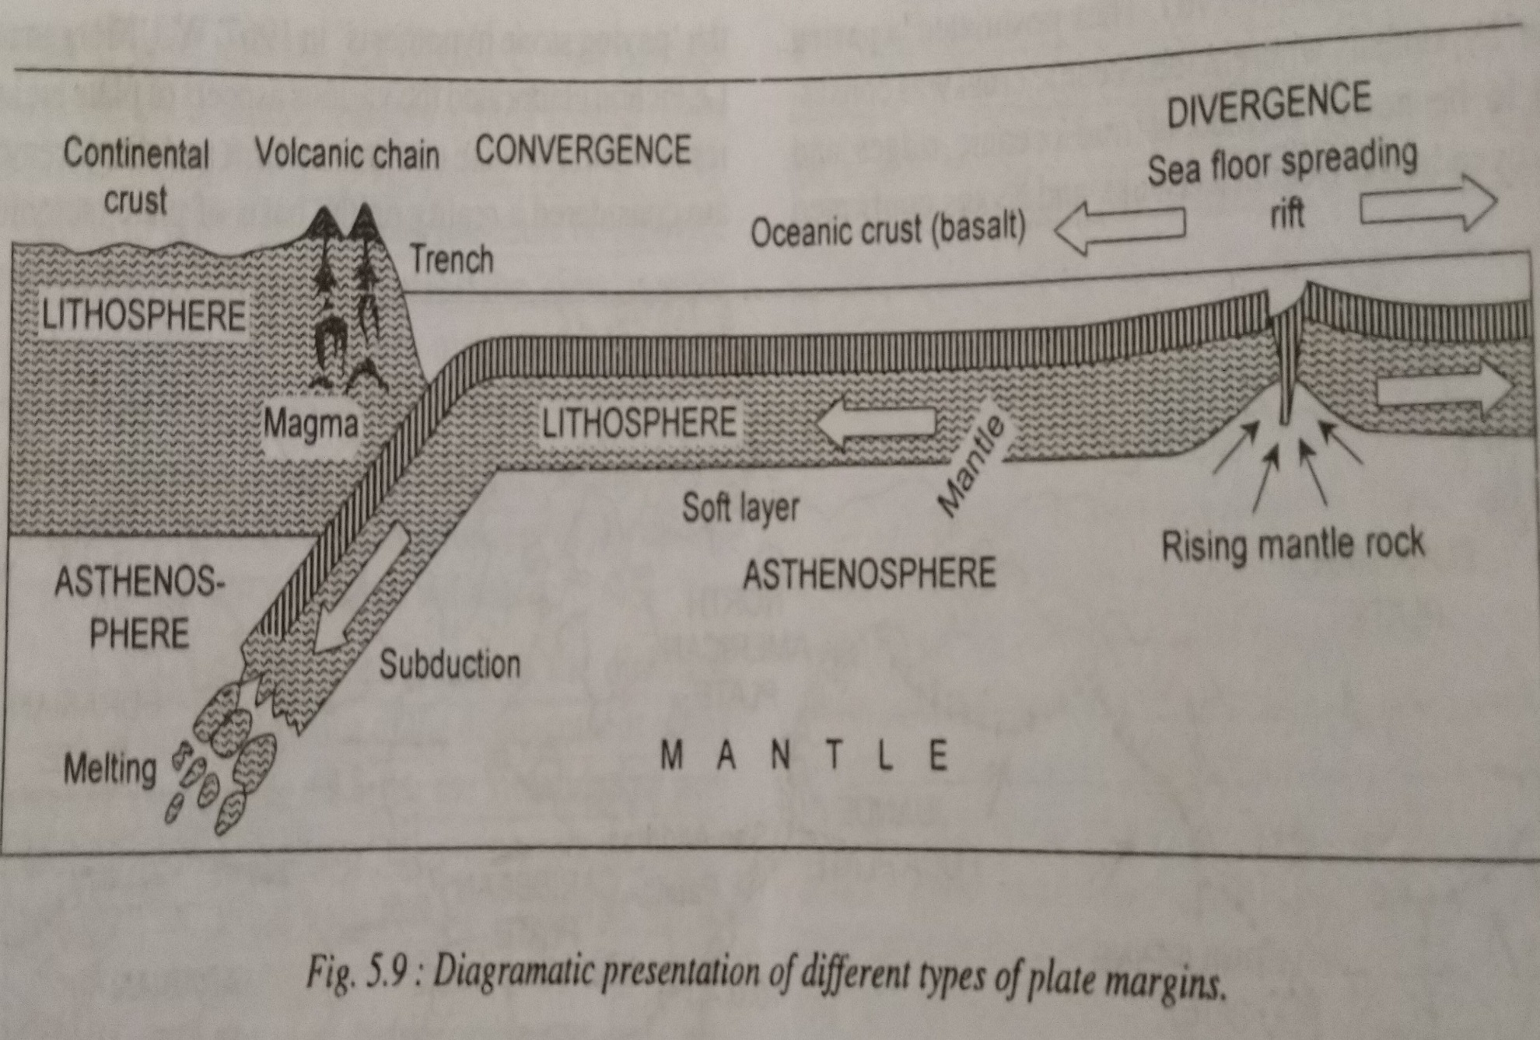
Diagrammatic Presentation

Slide 7
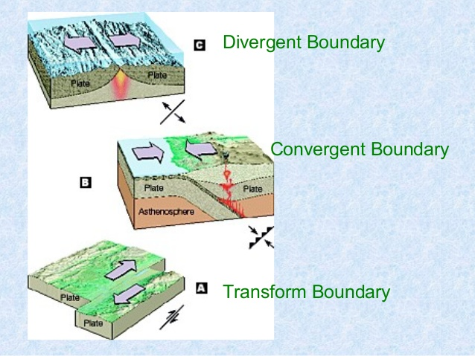
Types of plate boundary

Slide 8
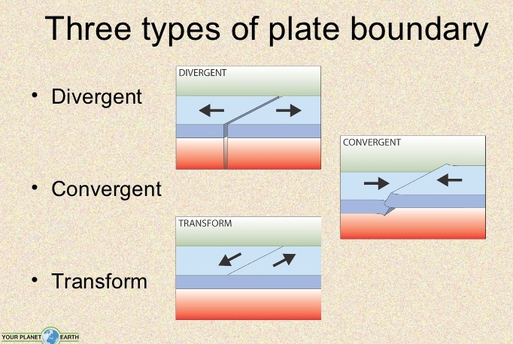

Slide 9
Constructive plate margins:- Are also called as ‘divergent plate margins’ or ‘accreting plate margins’.
Constructive plate margins represent zones of divergence where there is continuous upwelling of molten material and thus new oceanic crust is continuously formed. In fact, oceanic plates spilt apart along the mid-oceanic ridges and move in opposite directions.

Slide 10
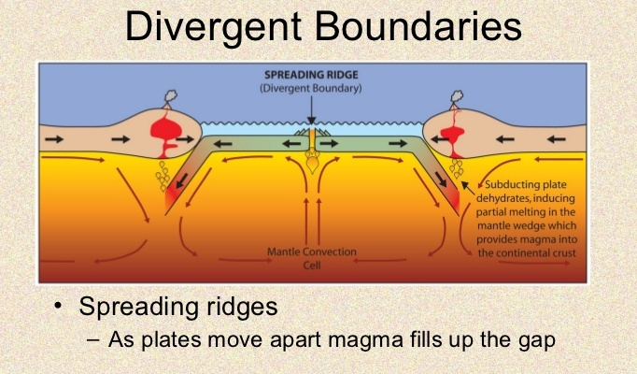

Slide 11
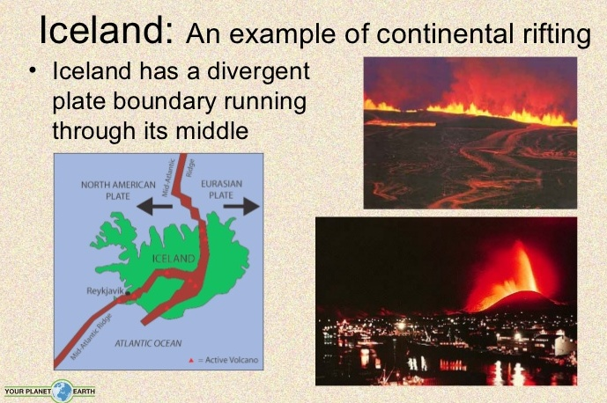

Slide 12
Destructive plate margins
Destructive plate margins are also called as ‘consuming plate margins’ or ‘convergent plate margins’. Because two plates move towards each other or two plates converge along a line and leading edge of one plate overrides the other plate and the overridden plate is subducted or thrust into the mantle and thus part of crust lost in the mantle.

Slide 13
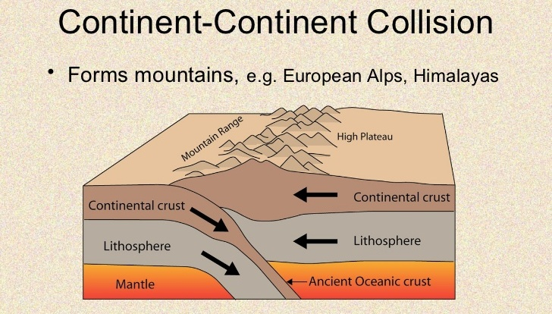
Convergent Boundary

Slide 14
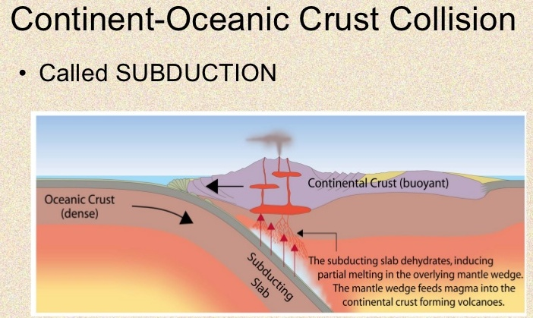

Slide 15
Conservative plate margins
Conservative plate margins are also called as ‘shear plate margins’. Here two plates pass or slide one another along transform faults and thus crust is neither created nor destroyed.

Slide 16
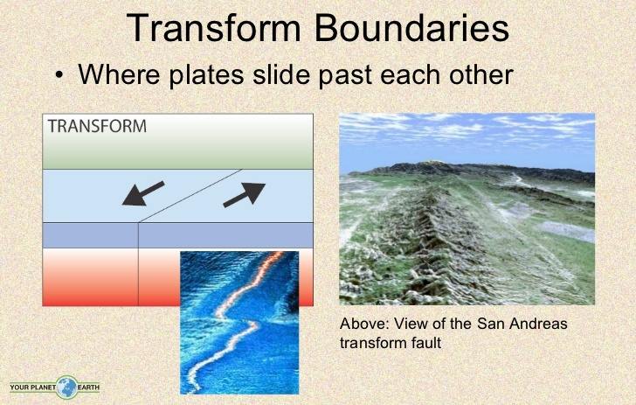
Transform boundary

Slide 17
Plate tectonic theory based on the evidences of:-
(1). Sea floor spreading
(2). Palaeomagnetism
Sea-floor spreading:
concept of sea floor spreading was first propounded by professor Hary Hess of the Peincepton University in the year 1960 AD.
His concept was based on the research findings of numerous marine geologists, geochemists and geophysicists.
Mason of the Scripps institute of oceanography obtained significant information about the magnetism of the rocks of the sea floor of pacific ocean with the help of magnetometer.

Slide 18
Based on these information Hary Hess propounded that the mid-oceanic ridge were situated on the rising thermal convection currents coming up from the mantle.
The oceanic crust moves in opposite directions from mid –oceanic ridges. These molten lava cool down and solidify to form new crust along the trailing ends of divergent plates(Oceanic crust).
Thus, there is continuous creation of new crust along the mid-oceanic ridges. This, according to Hess, proved the fact that sea-floor spreads along the mid oceanic ridges and expanding crusts are destroyed along the oceanic trenches.
These facts prove that the continents and ocean basin are in constant motion.

Slide 19
Convection current
When you boil a pot of water, the liquid moves around so rapidly? This is due to convection currents.
Convection is one of the three main types of heat transfer, the other two being conduction and radiation. Unlike the other two, convection can only happen in fluids.

Slide 20
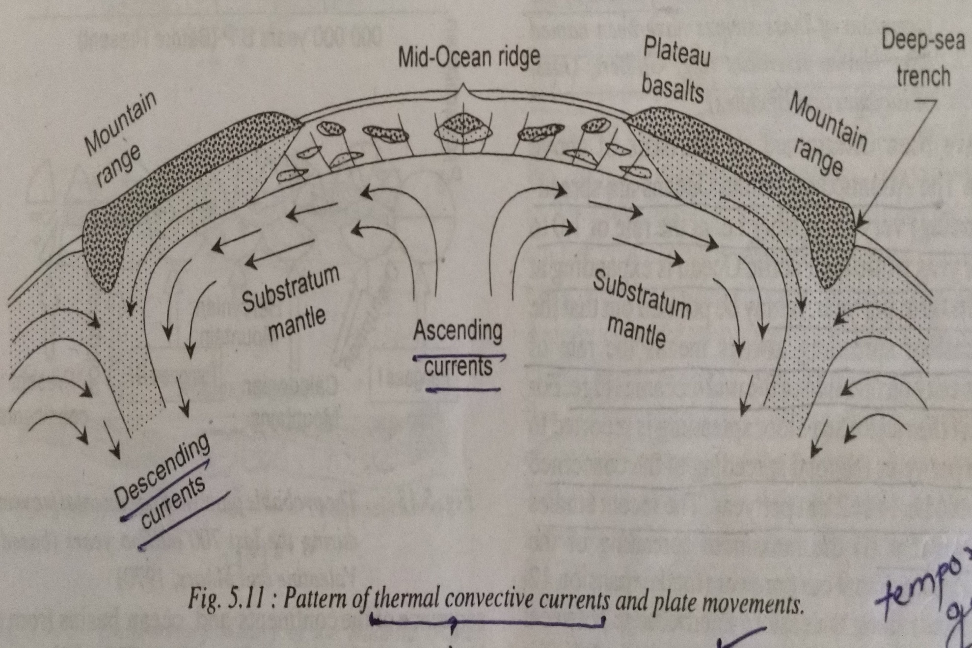

Slide 21
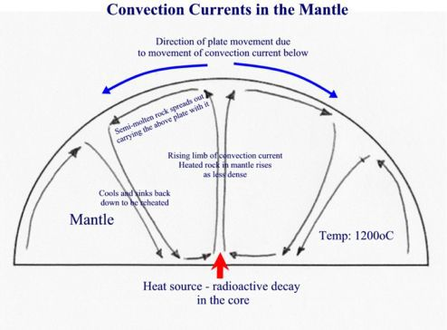

Slide 22
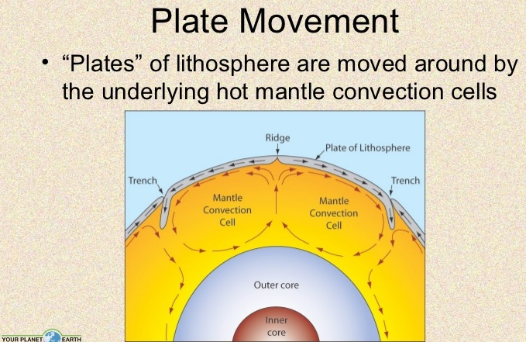

Slide 23
Palaeomagnetism
W.G. Vine and Mattheus conducted the magnetic survey of the central part of Carlsberg ridge in Indian ocean in 1963 and computed the magnetic profile on the basis of general magnetism.
When he compared the computed magnetic profile with the profile of magnetic anomalies plotted on the basis of actual data obtained during the survey, he found sizeable difference between the two profiles.

Slide 24
